Slide 1


Master of Science
Applied Data Science
Portfolio Milestone
Gilbert A Guyah
SUID: 963583327
10 May 2021

Slide 2
Agenda
Introduction
Program Learning Objectives
Course Projects
Personal Finance Database (IST 659)
Wine Project (IST687)
Sarcasm Tweets (IST 736)
Men’s NCAA Basketball (IST718)
Rise of Obesity/Overweight in the US (IST719)
Learning Objectives Demonstrated in Projects
Conclusion
References

Slide 3
Introduction
The School of Information Studies at Syracuse University Master of Science in Applied Data Science is an interdisciplinary program it provided students with the skills and ability to extract data from multiple domains, conduct assessments, and develop insight using various tools and techniques such as SQL Server Management Studio, Microsoft Access, and Excel, Abode Illustrator, Tableau, Weka, Python, and R Studio. Upon successful completion of this program, all students ought to be able to apply the learning objectives to real-world situations

Slide 4
Program Learning Objectives
1. Describe a broad overview of the major practice areas in data science.
2. Collect and organize data.
3. Identify patterns in data via visualization, statistical analysis, and data mining.
4. Develop alternative strategies based on the data.
5. Develop a plan of action to implement the business decisions derived from the analyses.
6. Demonstrate communication skills regarding data and its analysis for relevant professionals in their organization.
7. Synthesize the ethical dimensions of data science practice.

Slide 5


Personal Finance Database (IST 659)
INTRODUCTION: The database chosen to be developed was to track household spending over one year opportunity to improve financial decision marking by revealing saving option, unnecessary fees, and identify trends in spending habits

Slide 6
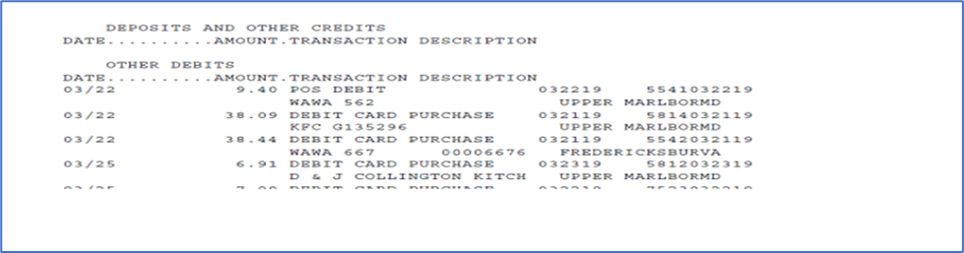
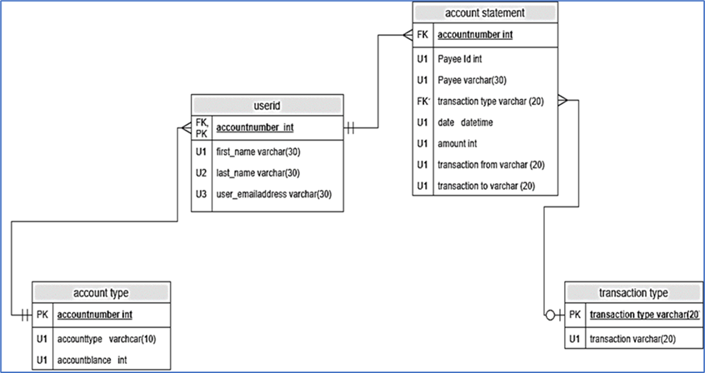
Personal Finance Database (IST 659)
METHODOLOGY: Normalized data extracted from banks statements, develop conceptual and logical models to organize the relationships between tables that were developed in SQL Server Management Studio, Graphical User Interface in Access, Excel to visualized the outputs
Sample Data Set
Logical Model

Slide 7
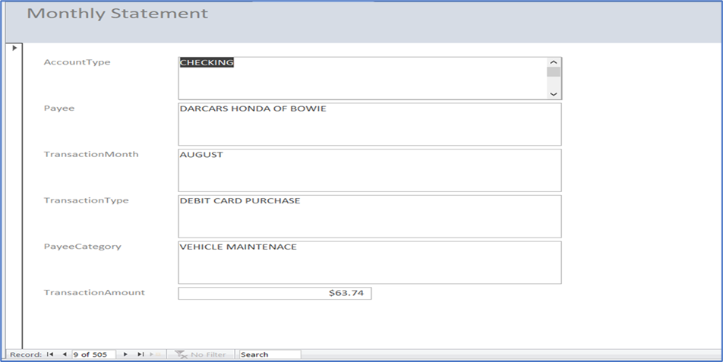
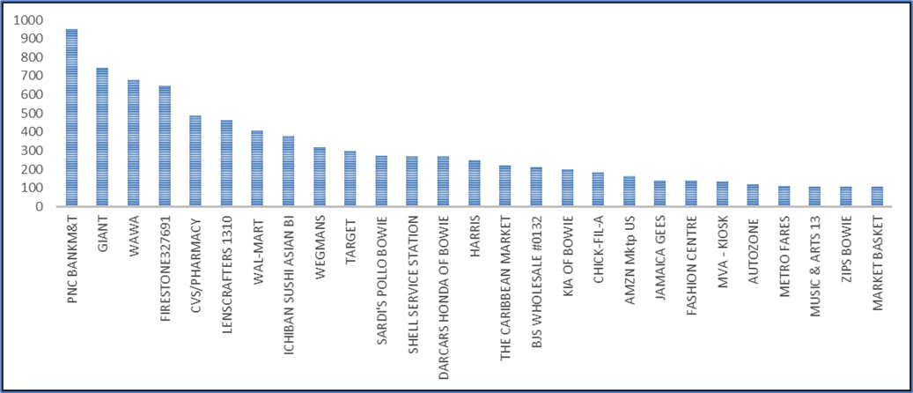
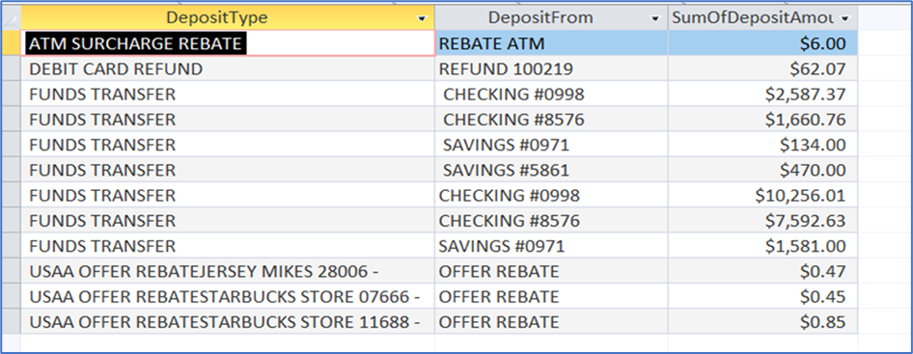
Personal Finance Database (IST 659)
RESULTS:
The questions this database will attempted to analyzed as follow:
•What is the average dollar amount per categories?

Slide 8
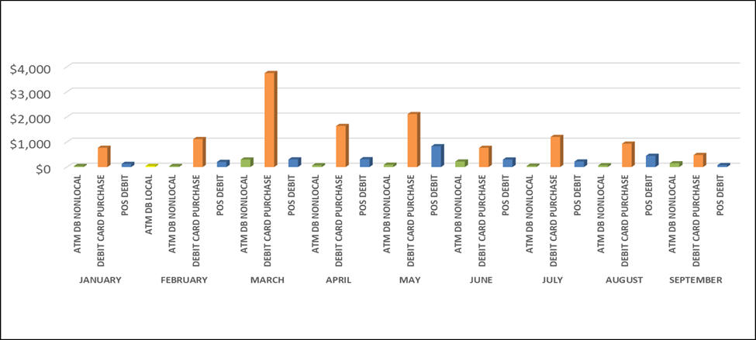
Personal Finance Database (IST 659)
Where can I look for cost savings or avoidance?
FOOD (LUNCH/DINNER/SNACK) 3316.42
GASOLINE 1883.15
MISC PURCHASE 1761.58
ATM 1008.35
Looking the highest 4 spending categories cost saving and avoidance can be done by change my spending habits. i.e., limit the amount of time the family eat out at a restaurant, bring lunch to work instead of buying, limit the miscellaneous purchase and ATM withdrawal.
Which month I spend the most and on what of Transaction?

Slide 9
Personal Finance Database (IST 659)
REFLECTION/CONCLUSION:
This project provides insight into how data is extracted, normalized, loaded, and transformed went developing a database to solve a problem or use other means. With no formal training on how a database was built, this was my first introductory course on the correct way to build a database and understand the terminology. Using Microsoft Excel Data Model and Pivot tables did not realize that structure of a database was embedded throughout the process, such as extracting the data from multiple sources using AdHoc quires, standardizing and normalizing the data, creating tables assigning foreign Keys and Primary Keys, developing conceptual and logical models then a star schema with nodes and various relationships: one to one, one to many, many to one, and many to many. Understanding the concept of a database, data modeling, and techniques will not struggle when developing a data model when solving a work-related or personal problem, this course has made me more effective a data analysis

Slide 10


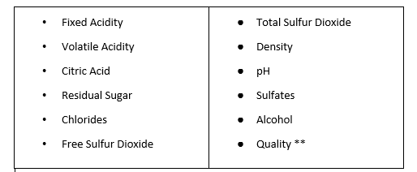
Wine Project (IST687)
INTRODUCTION: This projects goals was to use the wine quality data set from the UC Irvine Machine Learning Repository ( Containing 1,599 Red Wine Samples, 4,898 White Wine Samples, 12 attributes) and use attributes to determine wine quality.
Wine Attributes:

Slide 11
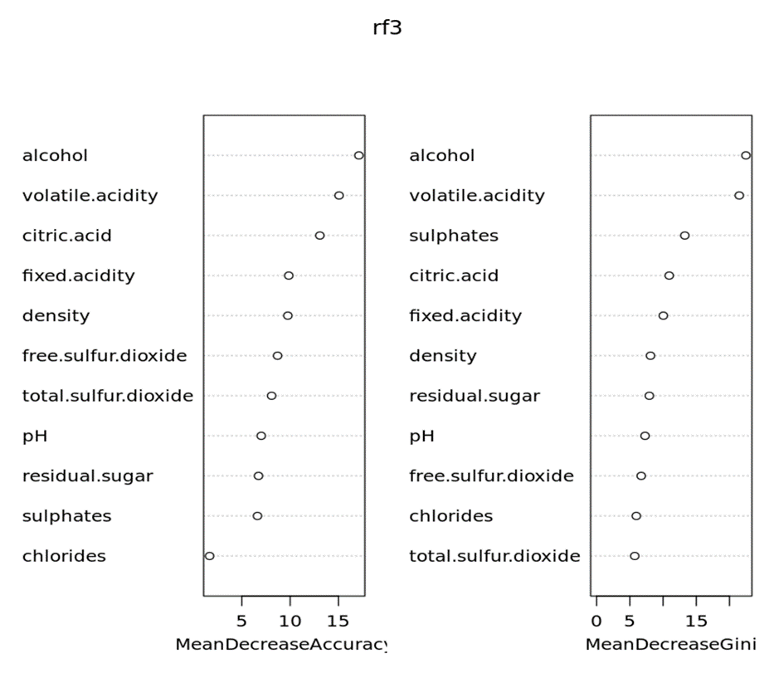
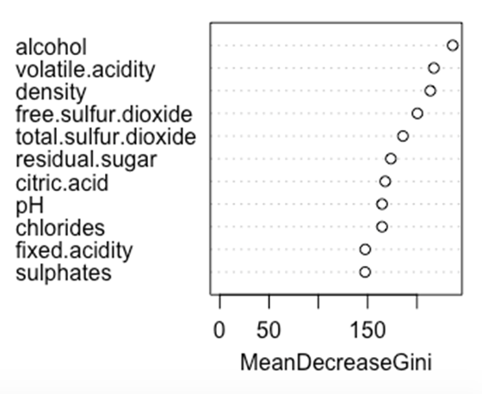
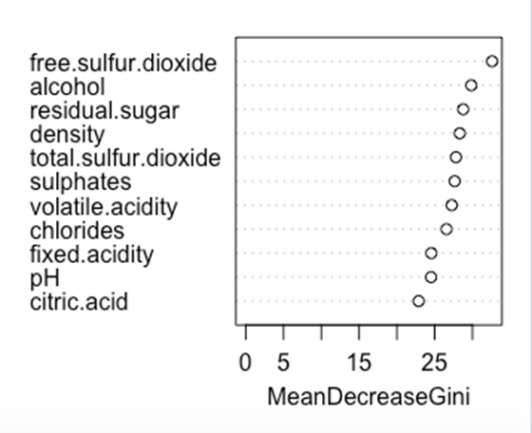
Wine Project (IST687)
METHODOLOGY:
Using RandomForest algorithm to obtain the significance of the variables. The top 4 variables were alcohol, density, volatile acidity, and free sulfur dioxide.
Random Forest Results (Red Wine)
Random Forest Results (White Wine)

Slide 12
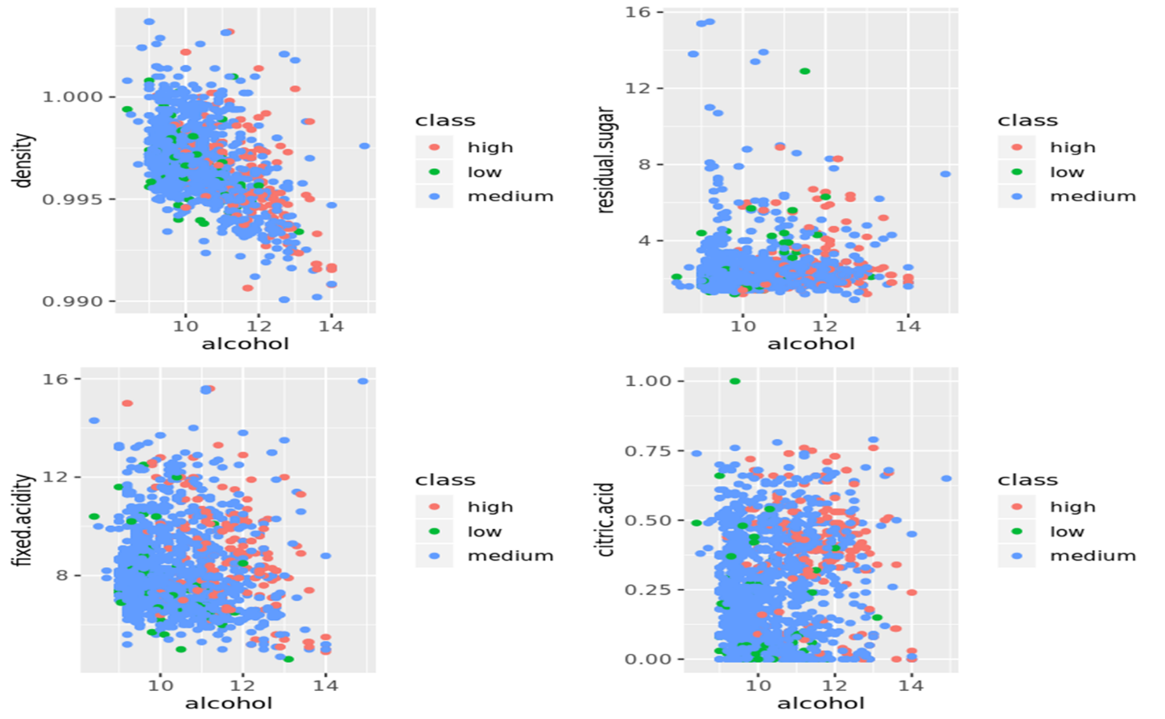
Wine Project (IST687)
RESULTS:
Lower density and higher alcohol content usually resulted in the wine being rated as higher quality.
There also seems to be a pattern where lower volatile acidity results in higher to medium level qualities, but this trend isn’t as strong as the others.
One reason the wines with high volatile acidity may be rated lower is that these wines tend to smell more strongly of vinegar which may result in a lower rating

Slide 13
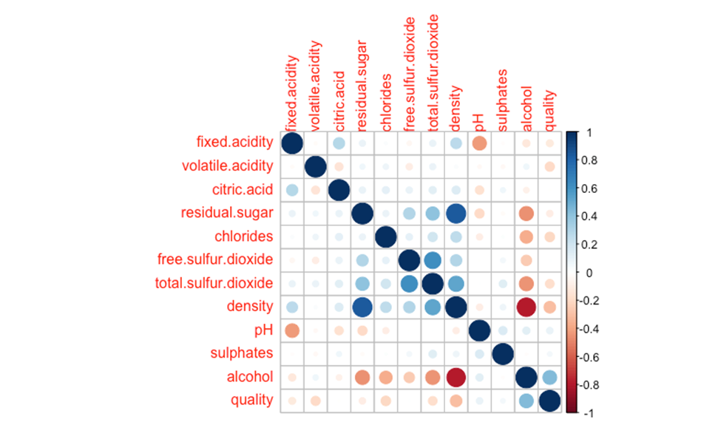
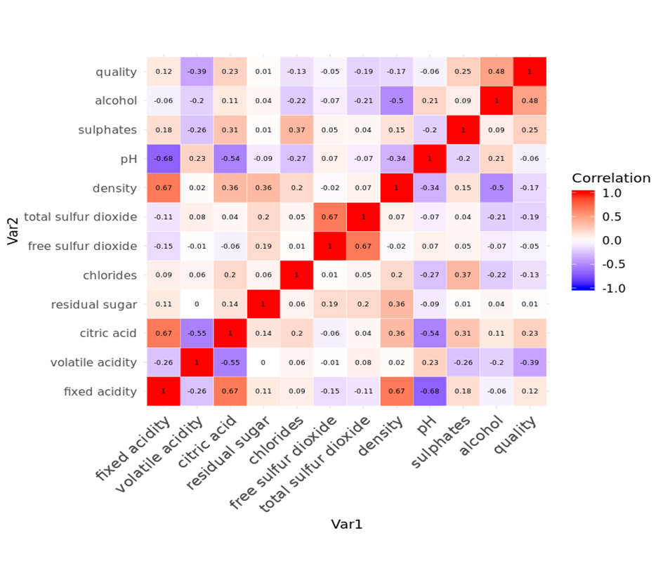
Wine Project (IST687)
Red Wine Correlation Matrix
White Wine Correlation Matrix
pH had a negative correlation with fixed acidity. Citric acid had a positive correlation with fix acidity and total sulfur dioxide one with free sulfur dioxide, neither were surprising. Density having a correlation with fix acidity was surprising. Alcohol having a positive correlation with quality
a positive correlation between density and residual sugar. There was a negative correlation between alcohol and density

Slide 14
Wine Project (IST687)
REFLECTION/CONCLUSION:
This being the first machine language course was overwhelming, ask weeks passed, completing the labs / watching the asynchronous videos along with live classes the concepts became more apparent.
Introduction to R Studio and Jupyter Notebook along with the various Statistical and visualization libraries
Introduction to collaboration tools such as Modular Interactive Data Science Tool (MIDST) and Machine learning techniques

Slide 15



Sarcasm Project (IST 736)
INTRODUCTION: This project was decided on premise on the understanding why sarcasm matters in our daily communication. Analyzing tweets is good example how people themselves ranging from self-deprecating, polite, obnoxious to raging.
While detecting sarcasm can be a challenge for humans, it is an even bigger obstacle for computers. When humans speak, it can be easier to pick up on verbal cues, body language, and tones that convey sarcasm.
What are the advantages and disadvantages of attempting to detect sarcasm using Machine learning algorithms? Is the question this project attempted to answer.

Slide 16
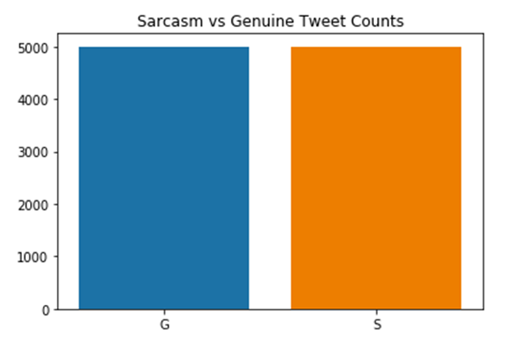
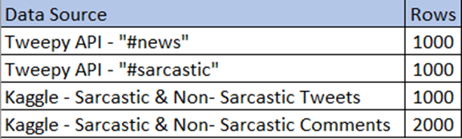
Sarcasm Project (IST 736)
The first dataset was extracted from Kaggle pertains to text data gathered from Reddit containing a “sarcasm” tag. This data contains over 32,000 rows and 10 columns including a “label” column
Secondly, tweets were extracted directly from the Twitter API through the Tweepy library. Six thousand tweets were collected using the search words “#sarcasm” and “#news” (3000 per search word Ultimately, a subset of 5000 rows
Breakdown of Subset for Analysis
Text Count (Sarcastic or Genuine)

Slide 17
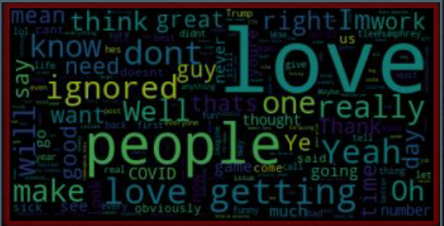
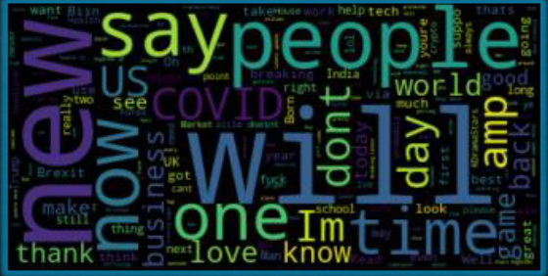
Sarcasm Project (IST 736)
Most sarcastic
1.thats
2.anita
3.having
4.said
5.sure
Feature Importance
Most sincere
1.Covid
2.breaking
3.business
4.If
5.More
Sarcastic
Sincere

Slide 18
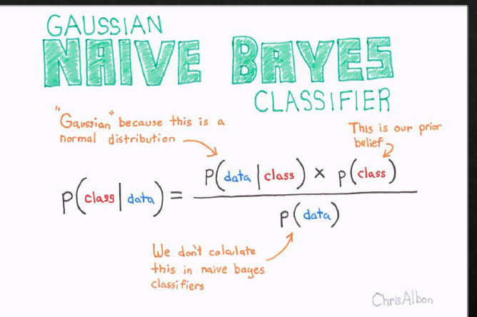
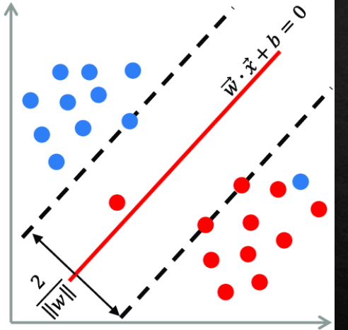
Sarcasm Project (IST 736)
METHODOLOGY:
Data cleaning and transformation occurred concurrently.
CountVectorizer and TfidfVectorizer from the Python library, Sklearn, were used to tokenize and create N-grams ranging from 1 to 3-word set
The data set was split to train set and test set. The size of the test set was set to 30% and the remaining 70% was used as a training set
Multinomial Naive Bayes and Support Vector Machine were selected as the algorithm to analyze the tweets
Naïve Bayes Accuracy 0.73
SVM Accuracy 0.71

Slide 19
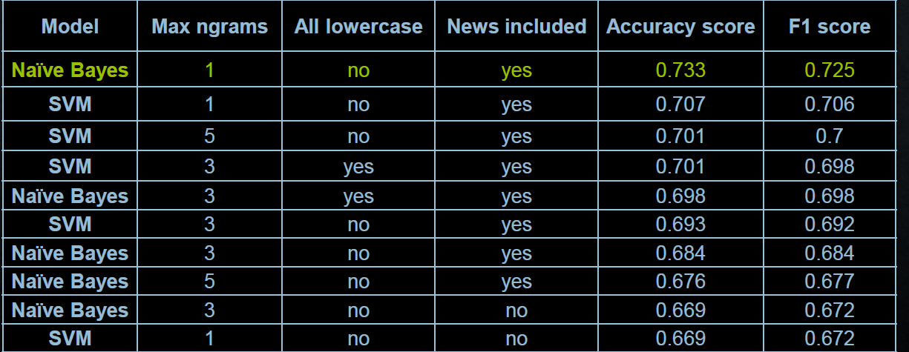
Sarcasm Project (IST 736)
RESULT OF ALGORITHMS:

Slide 20
Sarcasm Project (IST 736)
REFLECTION/CONCLUSION:
This project provides an insight that it is much harder to detect sarcasm in tweets and or written language observations. Learned that there are many different types of sarcasm, and these displayed by humans can vary.
There are 7 common types of sarcasm , ranging from self-deprecating, Brooding, Deadpan, polite, obnoxious, manic, and raging.
English language can be very complicated and easily misinterpreted. In a society where 280- character Tweets and Emojis are interchangeably used to convey moods, and emotions can improve sarcasm detection across the digital spectrum, could see how tweets can be misinterpreted.

Slide 21
Men's NCAA Basketball (IST718)
INTRODUCTION: Each season there are thousands of NCAA basketball games played between Division I men's teams, culminating in March Madness, the 68-team national championship that starts in the middle of March. As per Forbes.com, this year March Madness gambling is expected to break $8.5 Billion record.
The goal is to: Use historical data to accurately predict the winner of every possible match up in the NCAA Division I Basketball tournament.

Slide 22
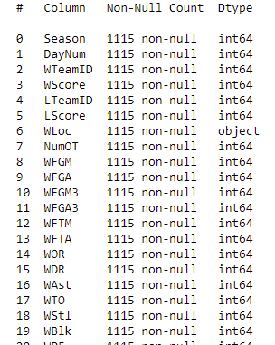
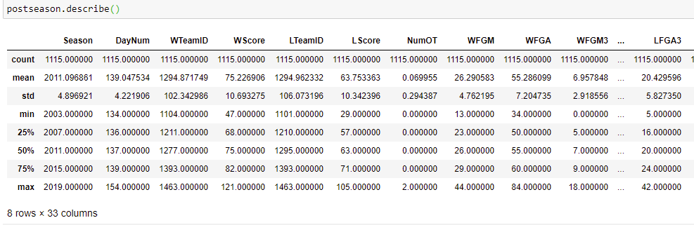
Men's NCAA Basketball (IST718)
The NCAAM Basketball Tournament dataset contains data from several sources.
About the data
The 357 Division-I Teams
Team names, conferences, rankings, location
Tournament seeds since 1984-85 season
Team stats for all regular season, conference tournament, and NCAA® tournament games since 2002-2003 season
Kenneth Massey historical data
Source: https://www.kaggle.com/c/ncaam-march-mania-2021/data

Slide 23
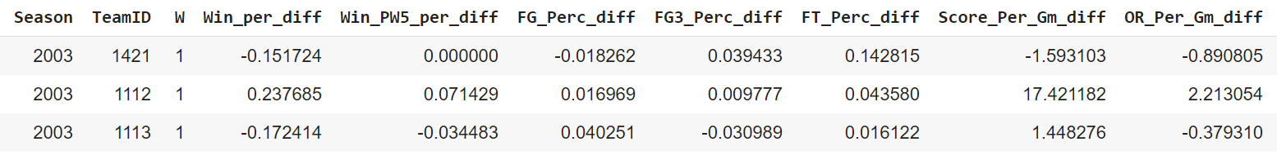
Men's NCAA Basketball (IST718)
Prepping Training and Test Data
Summarize all team stats performance by season
Calculate the difference of team stats performance between both teams facing each other in the tournament
Training data:
Modeling Techniques:
Contains historical data from 2003 to 2018 seasons
Random Forest
Logistic Regression
KNN
Naïve Bayes
Perceptron
Test data:
The data will be tested against the
2019 tournament
Source: https://www.kaggle.com/c/ncaam-march-mania-2021/data

Slide 24
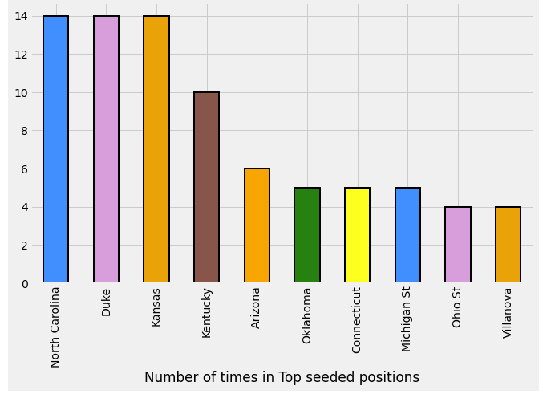
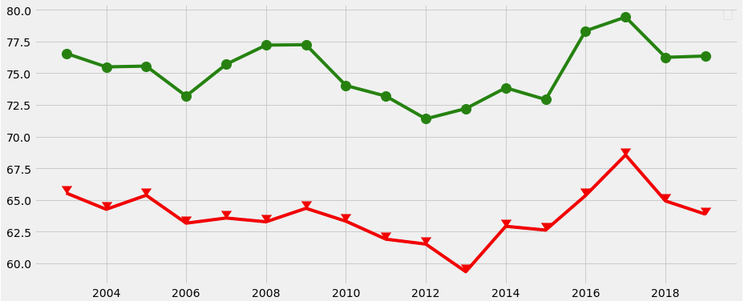
Men's NCAA Basketball (IST718)
North Carolina, Duke, and Kansas ranked the #1 seed the most
Tourney Detailed Results
Winning and Losing score Average over the years

Slide 25


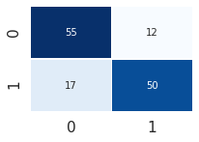

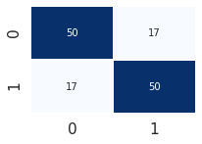





Men's NCAA Basketball (IST718)
The models were tested with the 2019 tournament. Random Forest model had the best accuracy in predicting the winner of the most games in the tournament. None of the models predicted the correct champion
Random Forest 1
Random Forest 2
Logistic Regression
n=100
n=300, max features =0.4
default
Acc =0.783582
Acc =0.731343
Acc =0.746269
2019 Champions
Virginia
KNN
Naïve Bayes
Perceptron
n=9
default
max iterations=8
Acc =0.626866
Acc =0.746269
Acc =0.738806
Predicted Winners: Duke, Tennessee, Gonzaga, and North Carolina
Source: https://www.kaggle.com/c/ncaam-march-mania-2021/data

Slide 26
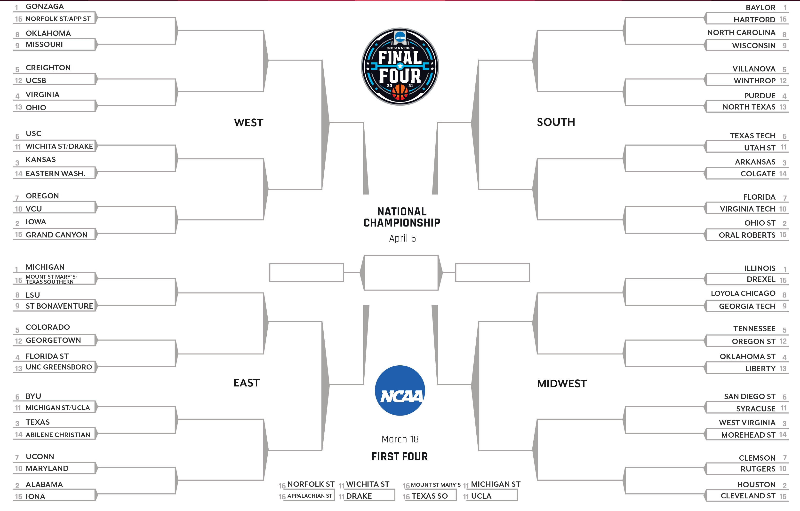
Men's NCAA Basketball (IST718)
GONZAGA
BAYLOR
GONZAGA
BAYLOR
OKLAHOMA
NORTH CAROLINA
GONZAGA
BAYLOR
UCSB
VIRGINIA
WINTHROP
WINTHROP
VIRGINIA
PURDUE
GONZAGA
BAYLOR
USC
TEXAS TECH
KANSAS
ARKANSAS
KANSAS
ARKANSAS
IOWA
OHIO ST
OREGON
FLORIDA
IOWA
OHIO ST
IOWA
OHIO ST
MICHIGAN
GONZAGA
BAYLOR
BAYLOR
ILLINOIS
MICHIGAN
ILLINOIS
LSU
GEORGIA TECH
MICHIGAN
TENNESSEE
COLORADO
TENNESSEE
FLORIDA ST
TENNESSEE
FLORIDA ST
OKLAHOMA ST
MICHIGAN
HOUSTON
UCLA
UCLA
SYRACUSE
SYRACUSE
TEXAS
WEST VIRGINIA
HOUSTON
UCONN
ALABAMA
CLEMSON
ALABAMA
Model: Random Forest 1
HOUSTON
ALABAMA
HOUSTON

Slide 27
Men's NCAA Basketball (IST718)
REFLECTION/CONCLUSION:
This was the most challenging course I have taken within the data science curriculum. It requires more than 100 percent of your time and attention.
This course is compilation of all the statical analysis courses taken, not to mention the advanced machine learning algorithms and scripting. (Prophet, ARAMA, Tensorflow, Neural Networks)
The homework assignments were challenging one felt they were on-the-job research for data to depict an accurate prediction and report.
This course provides me the best insight on what a data scientist and analysis is required to perform at an organization.

Slide 28

Rise of Obesity/Overweight in the US (IST719)
INTRODUCTION: The project was to developed an Adobe poster of a real-world problem, the chosen visualized was the increase in obesity in America based on age, gender, race, and education. The data set for this project came from the Behavioral Risk Factor Surveillance System (BRFSS) Prevalence Data (2011 to present) published Centers for Disease Control and Prevention.
Since the national adult obesity rate has increased by 26 percent since 2008 and is a major health issue resulting in numerous diseases, specifically increased risk of certain types of cancer, coronary artery disease, type 2 diabetes, stroke, as well as significant increases in early mortality and economic cost. The project questions will analyze the data to understand the effects of obesity in our society

Slide 29
Rise of Obesity/Overweight in the US (IST719)
METHODOLOGY: Using various R studio libraries:
library (lubridate) # work with dates
library(dplyr) # data manipulation (filter, summarize, mutate)
library(ggplot2) # graphics
library(gridExtra) # tile several plots next to each other
Use Adobe Illustrator
Clean the R plots
Add context and content
Create a poster
Create multiple dataframes from the original dataset to develop plots to answer the questions
dfage <- dfBMI[dfBMI$Break_Out_Category=="Age Group", ]
dfrace <- dfBMI[dfBMI$Break_Out_Category=="Race/Ethnicity", ]
Project Questions:
What is the BMI between being obese and being overweight by adults/male & female?
BMI is 18.5 to <25, it falls within the normal.
BMI is 25.0 to <30, it falls within the overweight range.
BMI is 30.0 or higher, it falls within the obese range.
Who is affected?
The States with highest rate of obesity between, groups (Gender, Race)?
What is the rate of increase in child obesity and by age group and state?
# Plot Education Groups
par(oma=c(3,3,0,1))
edbmi<- tapply(dfeducation$Data_value, list(dfeducation$Response,dfeducation$Break_Out), mean,na.rm=TRUE)
barplot(edbmi,beside = TRUE, las=2,main="BMI by Education", ylab=" ", col = rainbow(4))
legend("topright", title="BMI Range",
c("Normal", "Obese", "Overweight", "Underweight"), inset=.06, col = rainbow(4),fill=rainbow(4),ncol=2, cex=0.8, pch=19)

Slide 30
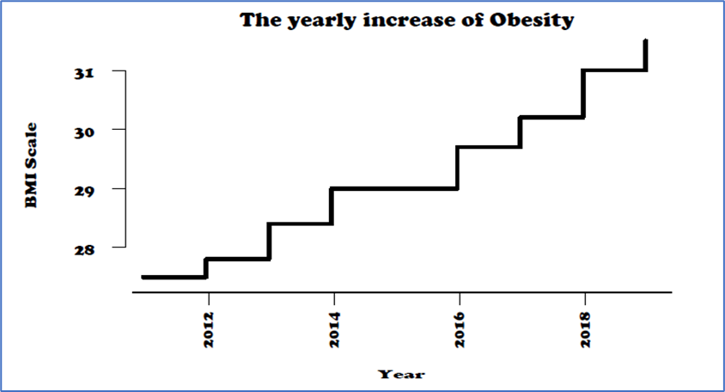
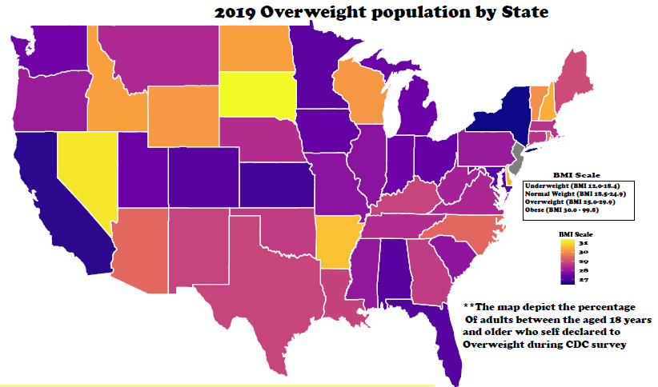
Rise of Obesity/Overweight in the US (IST719)
What is the BMI between being obese and being overweight by adults/male & female
Obesity Yearly Increase

Slide 31
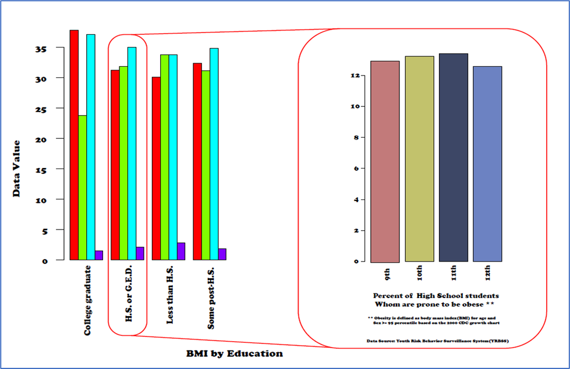
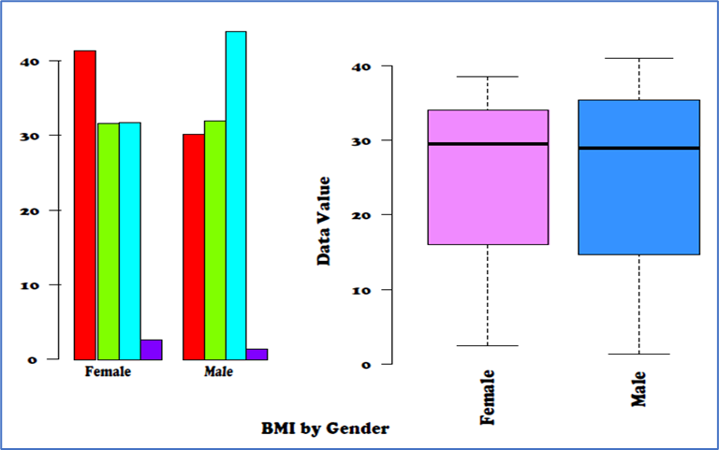
Rise of Obesity/Overweight in the US (IST719)
RESULT:
What groups have the highest obesity by education
The highest rate of obesity between Gender, Race

Slide 32
Rise of Obesity/Overweight in the US (IST719)
REFLECTION/CONCLUSION:
Using adobe illustrator to manipulate R visualization was very challenging since my only experience using adobe was to view pdf files, redact information within forms and or letters.
In addition, this course taught me how to use colors, layouts, charts, and fonts size to capture the audience's attention during the presentation.
Learn the concept of storytelling through data visualization and ascertain the intended audience attention

Slide 33
Learning Objectives Demonstrated in Projects
The portfolios chosen have demonstrated the learning objectives and the major practice areas in data science. The collection and organization of data using application programming interfaces and web scrapping to be analyzed using data mining and statistical techniques such as liner /logistics regression.
IST 659 - Collected and managed data using database solutions
IST 736 - Analyzed data using Naive Bayes, Support Vector Machine and Decision Tree classification techniques /clustered phrases and sources using Latent Dirichlet Allocation and K-Means Clustering
To implement the business decisions derived from the analyses, understanding the patterns using clustering techniques, help analysis develop alternative strategies, eliminate basis, and mitigate the ethical dimensions practices in data science.
IST 718 - Identify a data-focused problem, bring together different data sources, conduct analysis using TensorFlow and Spark, draw conclusions, and produce a report explaining the results
IST 687 - Used machine learning algorithms to conduct descriptive statistics analysis and communicate the results to decision makers

Slide 34
Learning Objectives Demonstrated in Projects
Demonstrate communication skills regarding data and its analysis for relevant professionals in their organization.
All the Projects for the courses (IST659, IST687, IST718, IST736, IST719) required an individual to enhance their written, oral, and presentation skills to able to effectively communicate results and present findings to a non data scientist i.e., Supervisor and or organization excecutives. No having these skill to articule results to excutives could lead to project failure and miscommunication.
Synthesize the ethical dimensions of data science practice when extracting data using APIs and web scrapping to ensure no person identifiable information are retrieved from external sources
IST736 - Requesting Tweets from through Twitter API ensuring only the relevant information requested are need for the project scope and the user privacy is protected
IST659 - Use of personal bank statement for this course project, only the data elements were use. The PII and privacy was protected in the collect and analysis
These projects are a representative of subset of course successful completed in this program. They have shown the execution of the learning objectives and the development of the essential skills desired in the field of data science.

Slide 35
Conclusion
Throughout the program, communication skills were developed and demonstrated in project reports and presentations regarding data and the analysis preform to ensure relevant professionals an organization can make effective decisions
Using the methods of learning in this program, a graduate can easily incorporate the skills acquired to confront real-world problems in corporate settings, develop and explain solutions to stakeholders.
As data scientists not investigating this pattern can result in decisions being to impact certain groups or part society, more even depict the wrong message for a person / corporate gains. i.e., corporation embellishing numbers or shown distorted charts

Slide 36
References
Chin, R. (2011, November 14). The Science of Sarcasm? Yeah, Right. Retrieved December 09, 2020, from https://www.smithsonianmag.com/science-nature/the-science-of-sarcasm-yeah-right-25038/
Geoffrey Hinton Quotes. (2020). Retrieved December 09, 2020, from https://www.brainyquote.com/quotes/geoffrey_hinton_875276
Guyah, G.A., (n.d), (2021) Guyah-Projects Retrieved from https://github.com/gilguyah/Guyah- Projects
Hoffer, J.A, Ramesh, V., & Topi, J. (2016). Modern database management (12th ed.). New York: Pearson
James, Gareth, Daniela Witten, Trevor Hastie, and Robert Tibshirani, An Introduction to Statistical Learning with Applications in R, Springer, 2013.
Kaggle Data Dictionary Retrieved from https://www.kaggle.com/c/ncaam-march-mania-2021/data
Merriam-Webster. (n.d.). Sarcasm. In Merriam-Webster.com dictionary. Retrieved December 9, 2020, from https://www.merriam-webster.com/dictionary/sarcasm
Miller, Thomas W., Modeling Techniques in Predictive Analytics with Python and R, Pearson, 2015
Watt, A. Chapter-13-database-development-process. Retrieved 24 October 2019. https://opentextbc.ca/dbdesign01/chapter/chapter-13-database-development-pocess

Slide 37
Thank you

